Slide 1
YOLO

Slide 2
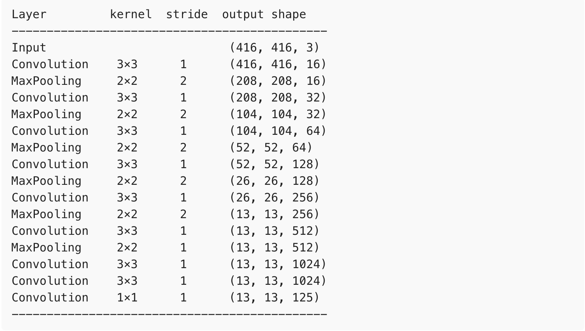
YOLO

Slide 3
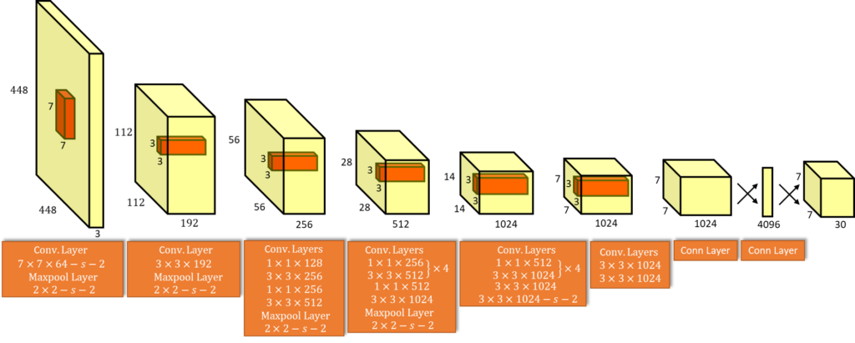
YOLO Architecture

Slide 4
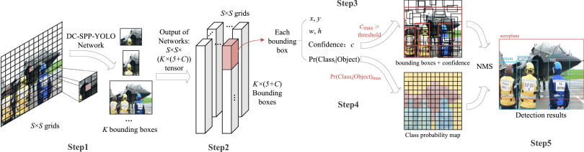
YOLO Process

Slide 5
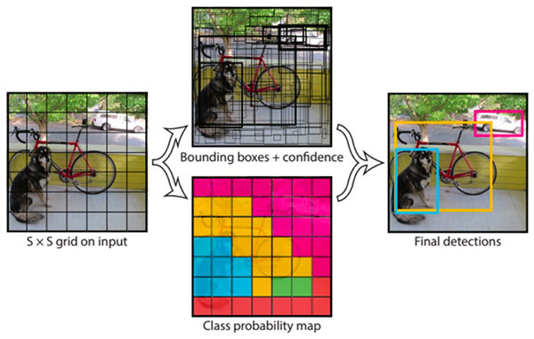
Yolo - detections

Slide 6
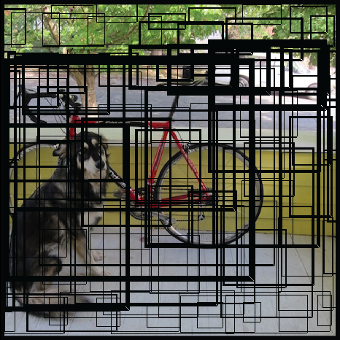
YOLO
YOLO actually looks at the image just once (hence its name: You Only Look Once) but in a clever way.
YOLO divides up the image into a grid of 13 by 13 cells:

Slide 7
YOLO
For each bounding box, the cell also predicts a class.
This works just like a classifier: it gives a probability distribution over all the possible classes.
YOLO was trained on the PASCAL VOC dataset, which can detect 20 different classes such as:
bicycle
boat
car
cat
dog
person

Slide 8
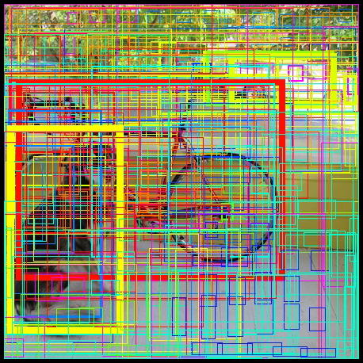
YOLO
The confidence score for the bounding box and the class prediction are combined into one final score that tells us the probability that this bounding box contains a specific type of object.

Slide 9
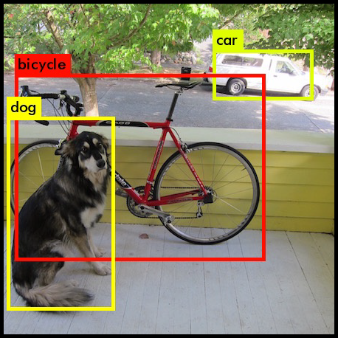
YOLO
Since there are 13×13 = 169 grid cells and each cell predicts 5 bounding boxes, we end up with 845 bounding boxes in total.
It turns out that most of these boxes will have very low confidence scores, so we only keep the boxes whose final score is 30% or more

Slide 10
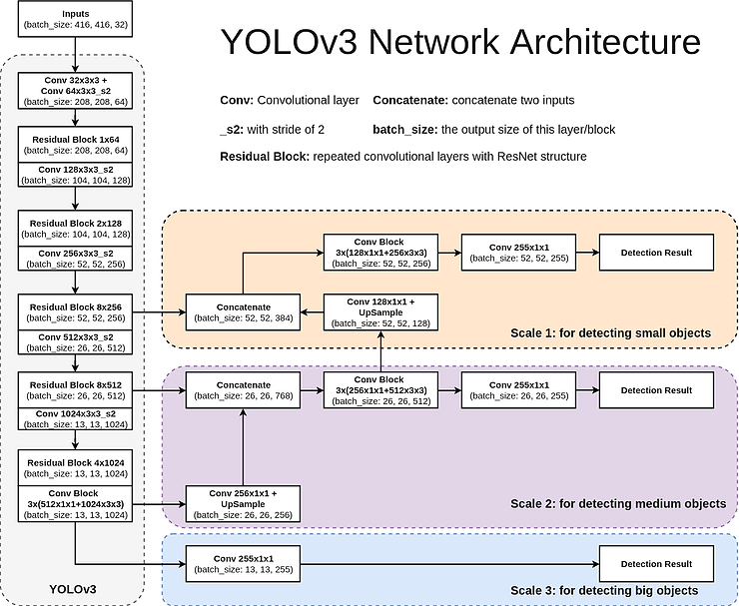

Slide 11
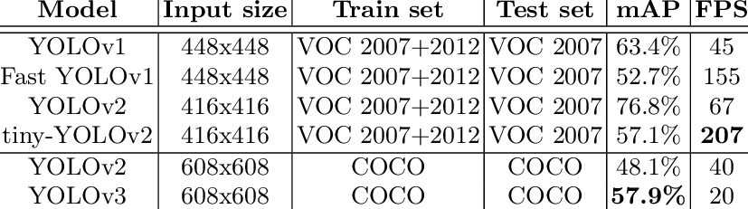
Yolo versions

Slide 12
YOLO
https://arxiv.org/pdf/1612.08242v1.pdf

